Slide 1
Enhancing Student Learning with CTSOs
Lisa Smothers, Director of Membership, National FBLA
Chris Dzurick, Education Program Consultant-CTSOs,
Iowa Department of Education

Slide 2

Icebreaker - Favorite App
Get up and find a partner who you don’t know
Share with them the favorite unique app you have on your phone
  Do not share basics like weather, news, etc
Ask questions about the app, why it is important, and how it improves or brings joy

Slide 3
Session Objectives
Objective 1
Participants will learn that CTSOs provide engaging programs that improve student achievement, reduce drop out rates, and help students discover career options.
05
Objective 5
CTSOs provide students with the opportunity to develop skills focused on creativity, problem solving, teamwork, and goal setting.
01
04
Objective 4
CTSOs bring relevance to the classroom and prepare students to be college and career ready.
Objective 2
CTSOs engage the community and local businesses to help students understand global competition and chart effective pathways for their personal success.
02
03
Objective 3
CTSO programs provide industry-based competitive and community service

Slide 4
What is a CTSO
A CTSO is a career and technical student organization
CTSOs are authorized under Perkins legislation
Student led and advisor supported professional membership associations that promote leadership, career development, and workplace and employability skills
CTSOs are intra-curricular to CTE programming
  Activities and standards are integrated into current coursework to support technical skill attainment
  CTSOs are not clubs or extracurriculars
CTSOs offer education and industry aligned competitive events, scholarships, and comprehensive learning programs
Notes:
The Smith-Hughes Act of 1917 was the first authorization for the Federal funding of vocational education. Subsequent legislation for vocational education (now termed career and technical education) included the Vocational Act of 1973 and the Carl D. Perkins Act of 1984 (Perkins). Perkins was reauthorized as the Carl D. Perkins Vocational and Applied Technology Act (Perkins II) in 1990, the Carl D. Perkins Career and Technical Education Act of 1998 (Perkins III), and the Carl D. Perkins Career and Technical Education Act of 2006 (Perkins IV).

Slide 5
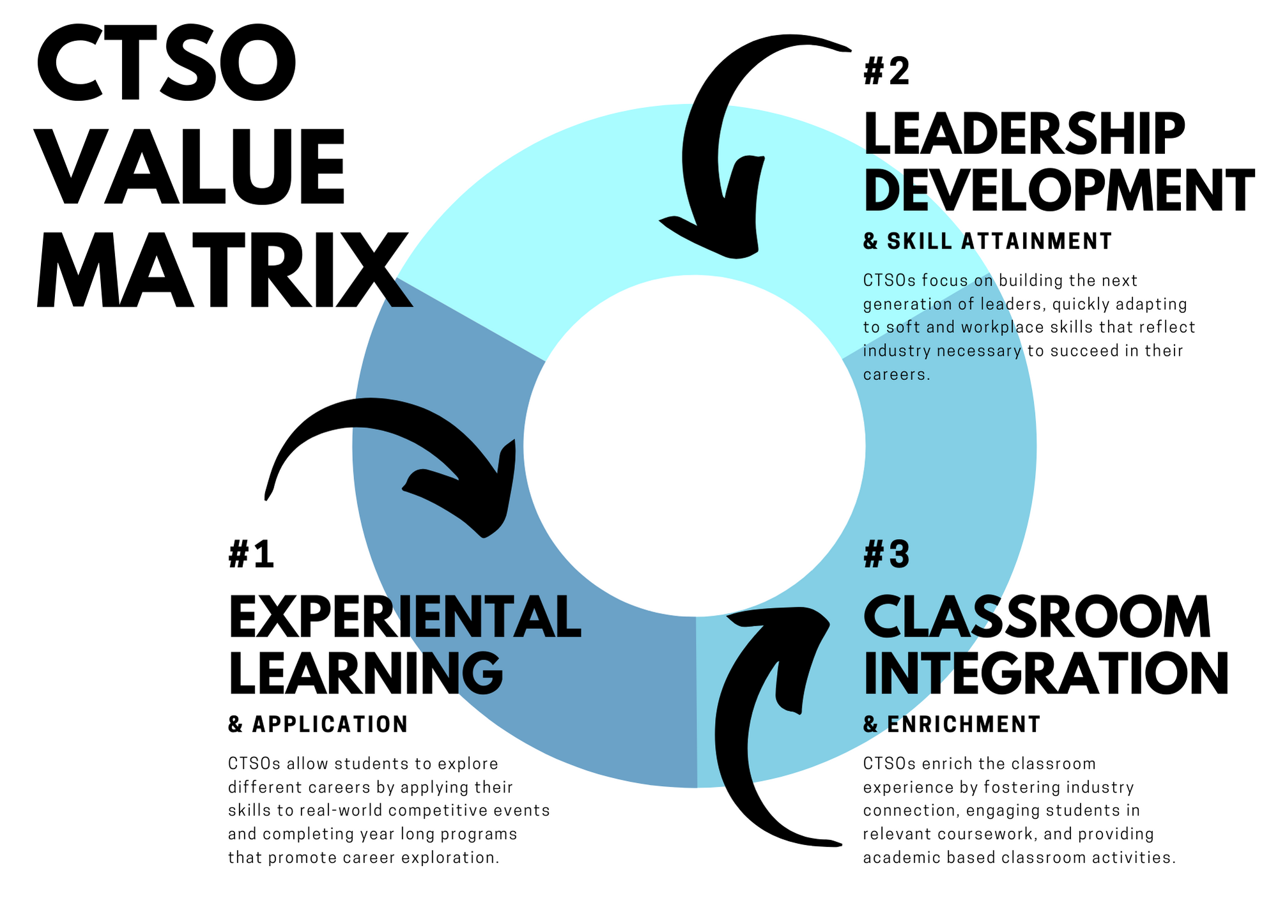
CTSO Purpose

Slide 6
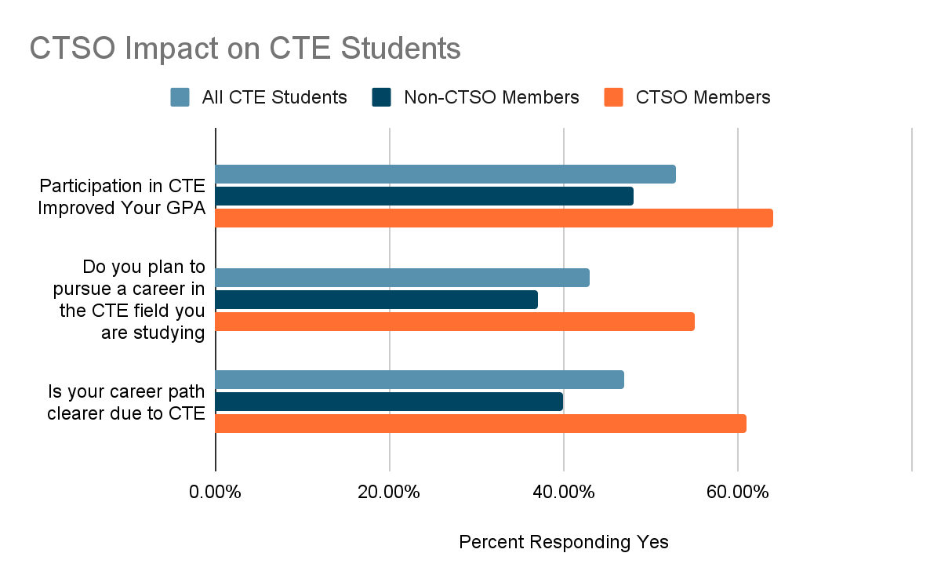
The Impact of CTSOs
+16% over non- CTSO members
+18% over non- CTSO members
+21% over non- CTSO members
Study conducted by The Manufacturing Institute in partnership with SkillsUSA and the Educational Research Center of America (October 2015)

Slide 7
CTSO Classroom Integration
Most CTSOs offer alignment to education and industry standards
CTSOs may be integrated into the classroom
  Using Competitive Event Topics, Guidelines, and Rating Sheets as Projects & Assessments
  Service Learning & Community Service Projects
  Development of Soft, Workplace, & Professional Skills
  Work Based & Project Based Learning
  Conferences & Events
Auxiliary recognition programs offer alignment to program standards for use as free time, bonus points, or fully integrated classroom activities
Comprehensive, year-long programs are adaptable to fit school needs
Notes:
All CTSOs offer a competitive events program that allows students to apply their classroom knowledge to real-world scenarios in their given career path. Topics, guidelines, and rating sheets are made available in advance, allowing students to review the expectations and rapidly apply what they have learned.
Host a localized contest and allow students to compete using a CTSO competitive event
Utilize competitive event topics for classroom projects and select the best project to advance on to official CTSO competitions
Break a contest down into manageable elements that run concurrently to your instruction.
Review the learning objectives and standards for each competitive event and how it mirrors classroom instruction or industry needs.
Service learning is a teaching and learning method that combines community service experiences with education related to civic engagement and responsibility, skill development, and academic achievement.
CTSOs, as membership associations, provide opportunities for students to connect to community service organizations. Student members learn to apply their classroom instruction to real world scenarios, helping them to engage in their local community, gain workplace and employability skills, and explore careers. Youth who are more engaged in their community and more likely to seek ways to improve the community and are more likely to be committed to community service in their futures.
Through leadership development programs, student members gain the skills necessary to be successful in their future education and careers. These skills, demanded by industry, help students who complete CTSO programs to be more attractive to employers.

Slide 8
Competitive Events
CTSO competitive event programs allow students to apply their classroom knowledge to real-world scenarios in their given career path
Topics, guidelines, and rating sheets are made available in advance, allowing students to review the expectations and rapidly apply what they have learned
Integration Ideas
  Host a localized contest and allow students to compete using a CTSO competitive event
  Utilize competitive event topics for classroom projects and select the best project to advance on to official CTSO competitions
  Break a contest down into manageable elements that run concurrently to your instruction.
  Review the learning objectives and standards for each competitive event and how it mirrors classroom instruction or industry needs.

Slide 9
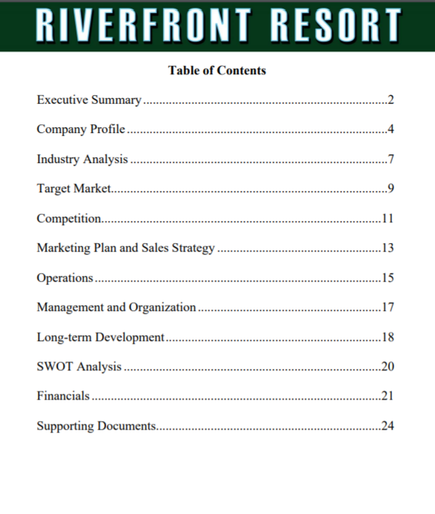
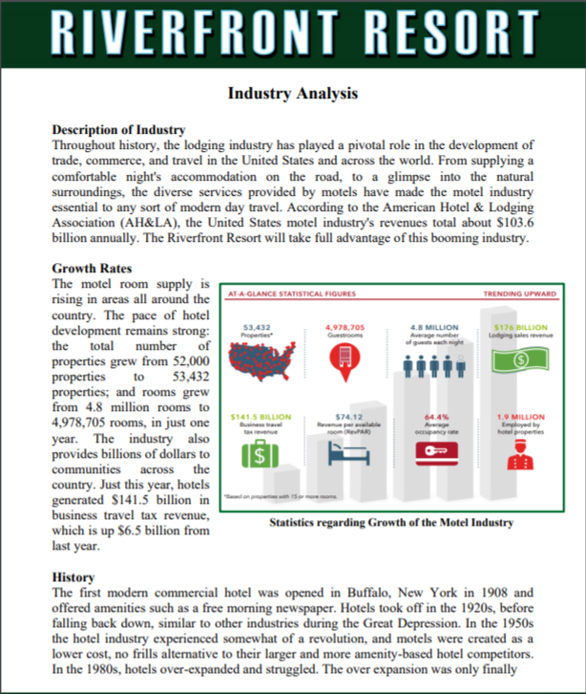
FBLA Business Plan
This event recognizes FBLA members that demonstrate an understanding and mastery of the process required to develop and implement a new business venture
An effective business plan should include the following information
  Executive Summary
  Company Description
  Industry Analysis
  Target Market
  Competitive Analysis
  Marketing Plan and Sales Strategy
  Operations
  Management and Organization
  Long-Term Development
  Financials

Slide 10
Crosswalk to MBA Research Business Administration
FBLA Performance Competencies | Business Administration Performance Indicators
Develop a business plan Describe business concept and company profile Describe operations and management plans Provide understandable final documents and projections | Develop business plan (SM:013) (ON)
Present clear, concise report with logical arrangement of information Use professional written presentation appropriate to the audience Write report using proper grammar, punctuation, spelling, and acceptable business style | Explain the nature of effective written communications (CO:016) (CS) Prepare reports (NF:181) (CS) Write research reports (CO:186) (SP)
Cover marketing aspects of business thoroughly | Conduct market analysis (market size, area, potential, etc.) (MP:009) (MN)
Anticipate, analyze, and plan for risks | Assess risks associated with venture (EN:010) (ON) Evaluate risk-taking opportunities (EN:024) (ON) Measure risk (RM:049) (MN)
Identify reasonable long-term goals | Develop company goals/objectives (SM:008) (ON)

Slide 11
Service Learning
Teaching and learning method that combines community service experiences with education related to civic engagement and responsibility, skill development, and academic achievement
CTSO members learn to apply their classroom instruction to real world scenarios, helping them to
  Engage in their local community
  Gain workplace and employability skills
  Explore careers
Youth who are more engaged in their community are
  More likely to seek ways to improve the community
  More likely to be committed to community service in their futures.
Most CTSOs have a community service based competitive event, offer a community service recognition program, or have national service partners

Slide 12
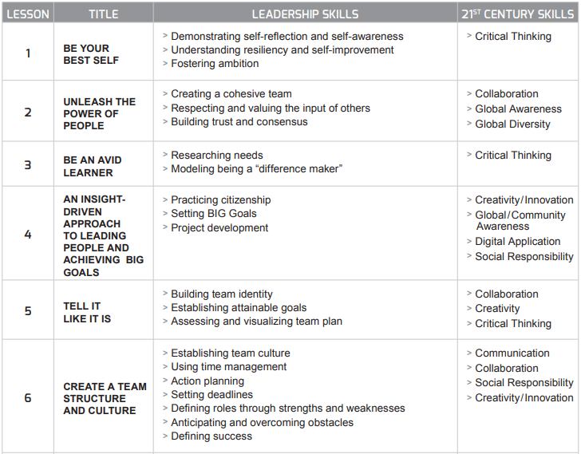
Lead4Change
Fills a gap education by giving students the opportunity to lead, create and implement team projects designed to meet a need in their school, local or global community
Comprehensive lessons are aligned to education standards
Partner with BPA, DECA, FBLA, FCCLA & HOSA

Slide 13
Skill Development
Through leadership development programs, student members gain the skills necessary to be successful in their future education and careers. These skills, demanded by industry, help students who complete CTSO programs to be more attractive to employers.

Slide 14
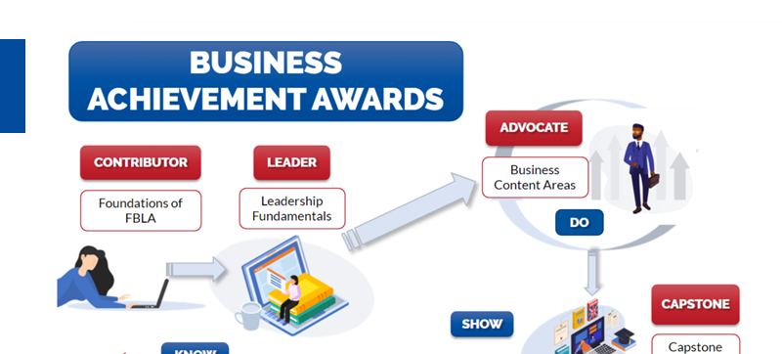
Skill Development Example
BAA

Slide 15

BAA ADVOCATE AWARD
Deeper Dive into Business Content Areas
Currently Available:
                Understanding Business Ethics
      Coming in 2022:
      Design Thinking
Coming this Fall:
                Personal Branding
      Have specific topics that you would like to see?
      Vote in the Learning Center for the topics most important to you!
© FBLA, 2021 All rights reserved

Slide 16
BAA LEADER AWARD
Leadership Fundamentals
Module One: Inner Leader
                Understanding Values
                Communication Style
                Power of Diversity and Inclusive Language
      Module Two: Emotional Intelligence
      Why are Emotions Important?
      What is Emotional Intelligence?
      The Emotional Intelligence 2.0 Model
      Improving your Emotional Intelligence
Module Three: Leading and Influencing
                Positive Mindset
                Taking Personal Responsibility
                Lateral Leadership
      Module Four: Working in Teams
      Advantages of Working in Teams
      Tower of Successful Teams
      S.M.A.R.T. Goals
© FBLA, 2021 All rights reserved

Slide 17
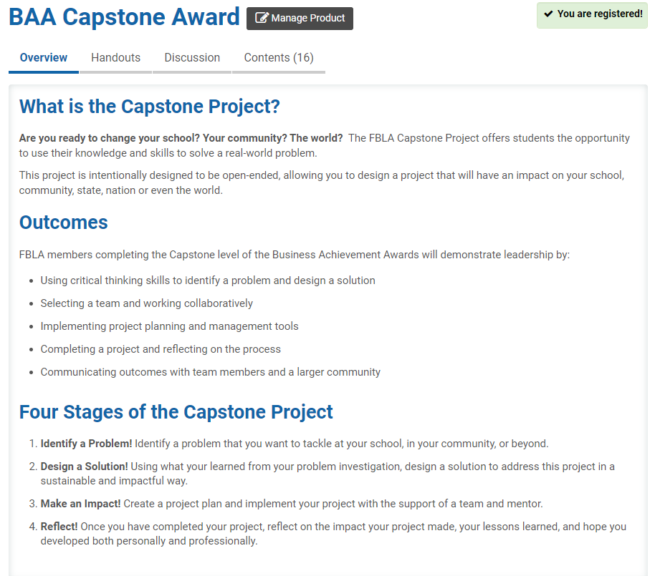

© FBLA, 2021 All rights reserved

Slide 18

WHY COMPLETE THE CAPSTONE AWARD?
Develop Project Management Skills!
Develop Leadership Skills!
Expand Your Network!
Earn Prize Money!
© FBLA, 2021 All rights reserved

Slide 19
Work and Project Based Learning
Work based learning may take place within a CTSO to connect classroom learning to the workplace through application and workplace mentorship
  CTSOs offer direct industry connection
  Members align their academic knowledge to real workplace tasks
  360-degree approach permits students to reflect on their learning process
  Strong WBL relationships may qualify for course credit and generate CTSO projects
Project based learning focuses on a problem or challenge over a long period of time through hands-on learning
  Members are able to complete multiple activities related to the problem or challenge that runs concurrent to course instruction
  Tangible results are produced along the way, show student the applicability of coursework
  Members gain critical thinking skills.
  Projects may align to course standards

Slide 20


Work and Project Based Learning Example
Knowledge Matters or D4D

Slide 21
Conferences and Events
Conferences and events are extensions of the classroom
  Enrich the CTE experience for CTSO students
  Provide connection to business and industry professionals
  Share what industry demands are of students seeking employment/post-secondary education
  Showcase the latest innovations in their field, including technology
  Partake in leadership and skill development exercises to gain skills necessary for future career success
Student members are able to engage with their peers
  Create a professional networking that includes new and diverse backgrounds
  Participate in lively discussions, hear new ideas and perspectives, and refine their own understanding of important topics and concepts
Through travel to new destinations, students gain a deeper understanding of how they and their community fit into the greater global society

Slide 22
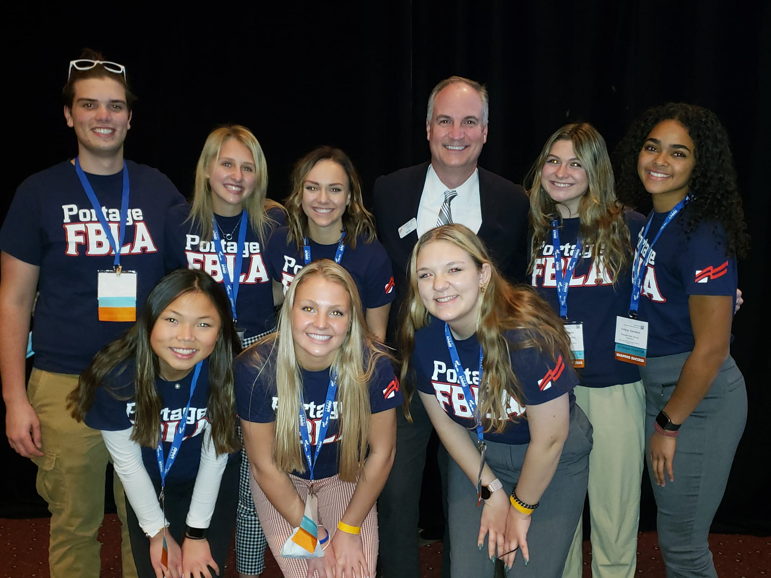
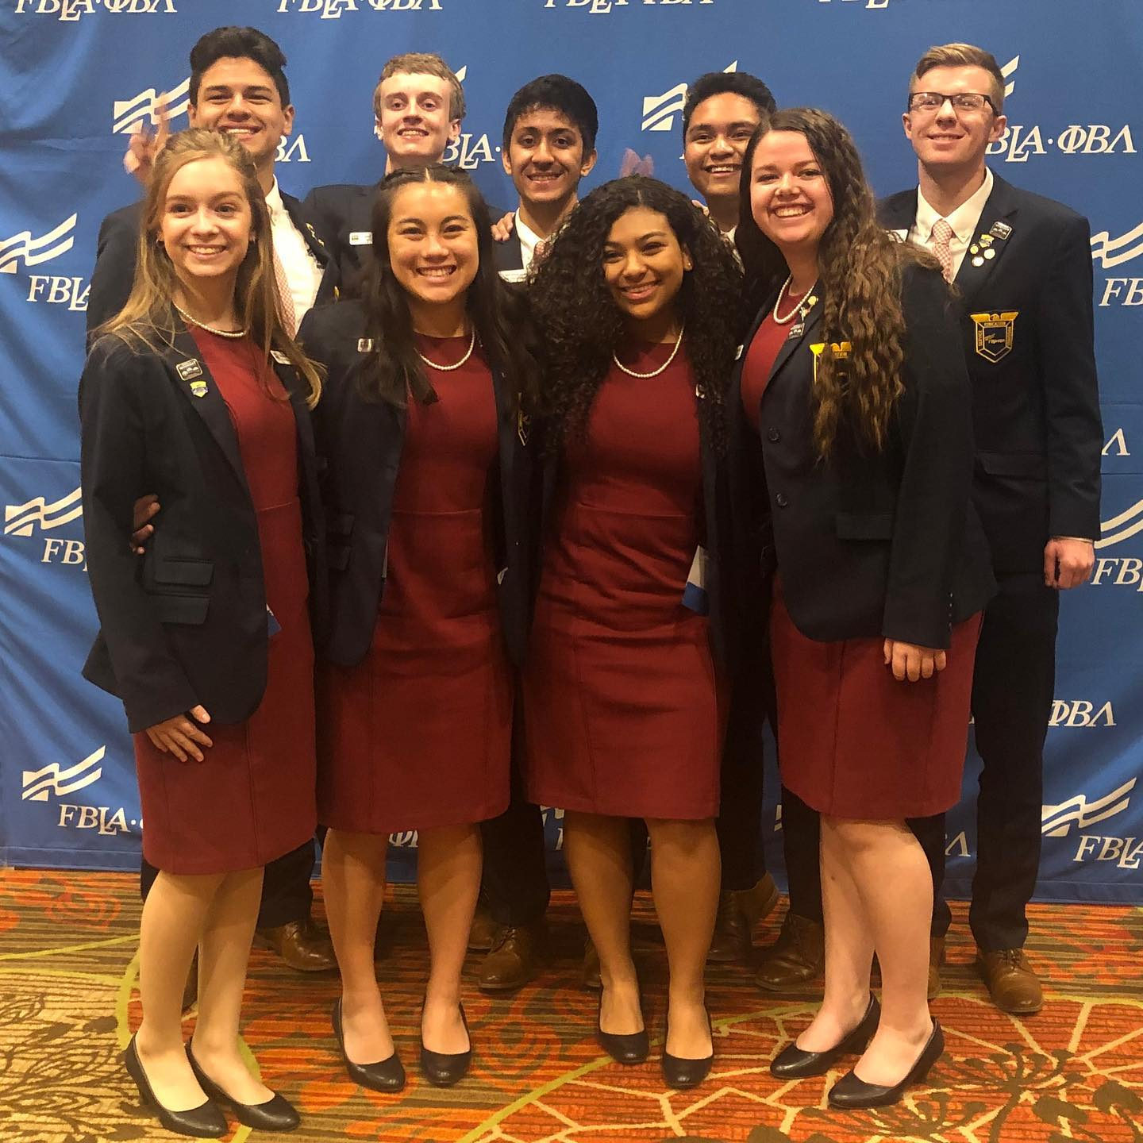

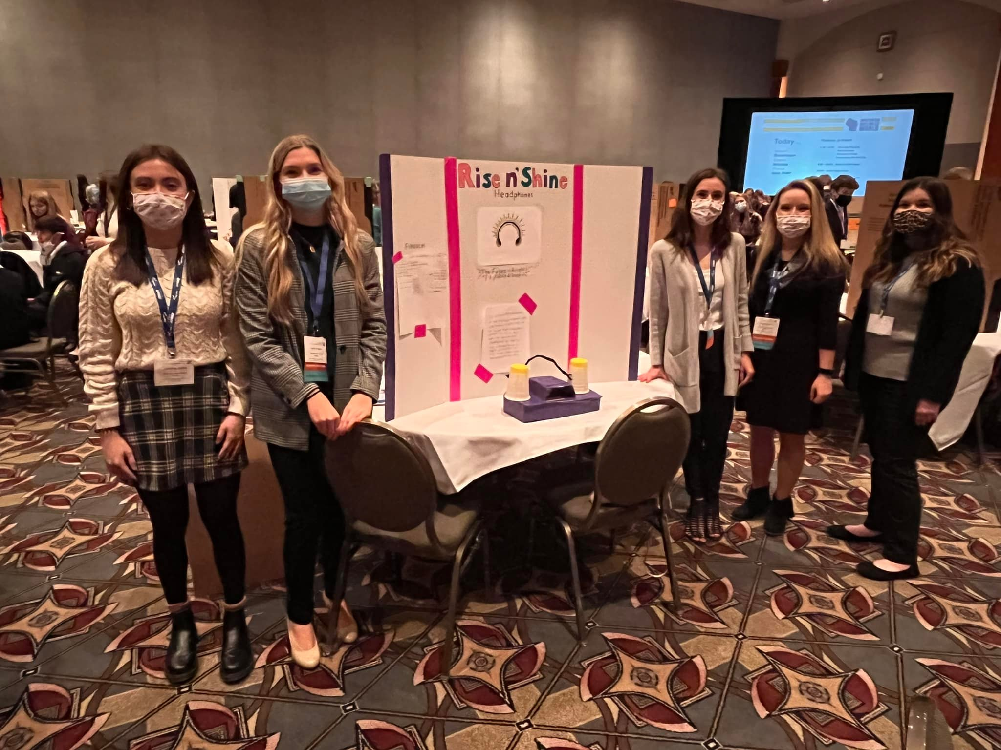

Conferences and Events Example
Networking and Professionalism
Business Pitches and Keynote Speakers

Slide 23
Questions?

